Slide 1
結果 ②Seeligeria

Slide 2
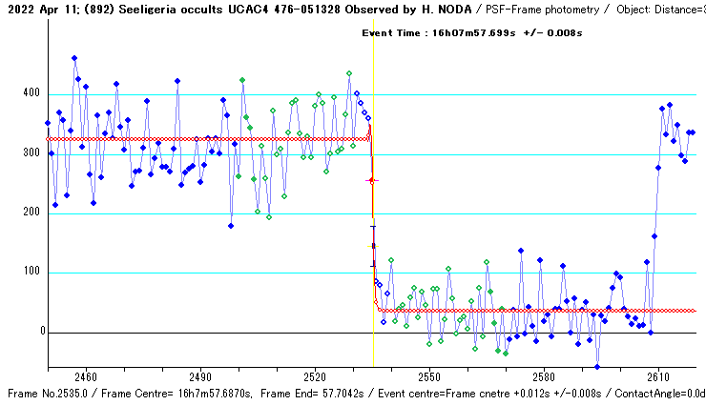
減光
Estimated Magnitude
Mag Drop : 2.38 +/- 0.04 Mag.
-Statistical analysis of Light Intensity-
Average Stdv n
Combined : 324.7 62.0 31
Background: 36.2 42.6 31
Noise Level (N/S) Upper Lower (S/N)
Total event: 0.2149 0.1476 4.65
- Event Time ----------------------------
Observed with 0 frame integration.
Event Time : 16h07m57.699s +/- 0.008s
Deriving process is :
T = To + Offset
= 16h7m57.6870s+0.012
Notes:
山村さん説明の赤点クリックの後は「Diffraction Analysis」を押すとサイドメニューFresnel…が出てくる

Slide 3
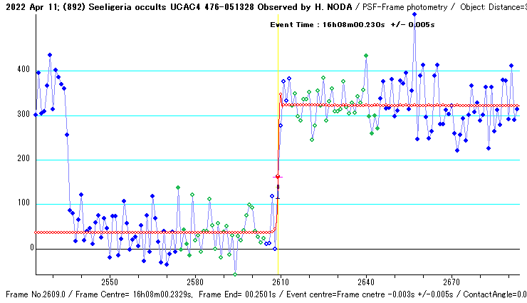
復光
Estimated Magnitude
Mag Drop : 2.37 +/- 0.04 Mag.
-Statistical analysis of Light Intensity-
Average Stdv n
Combined : 322.7 38.9 31
Background: 36.2 43.5 31
Noise Level (N/S) Upper Lower (S/N)
Total event: 0.1359 0.1518 6.59
- Event Time ----------------------------
Observed with 0 frame integration.
Event Time : 16h08m00.230s +/- 0.005s
Deriving process is :
T = To + Offset
= 16h08m00.2329s-0.003

