Slide 1
結果 ①Dufour

Slide 2
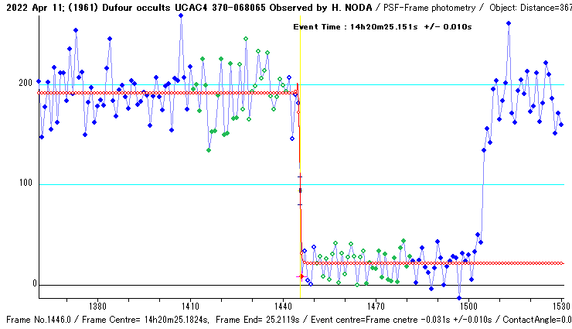
減光
Estimated Magnitude
Mag Drop : 2.39 +/- 0.02 Mag.
-Statistical analysis of Light Intensity-
Average Stdv n
Combined : 191.3 28.1 31
Background: 21.2 13.3 31
Noise Level (N/S) Upper Lower (S/N)
Total event: 0.1652 0.0783 6.05
- Event Time ----------------------------
Observed with 0 frame integration.
Event Time : 14h20m25.151s +/- 0.010s
Deriving process is :
T = To + Offset
= 14h20m25.1824s-0.031

Slide 3
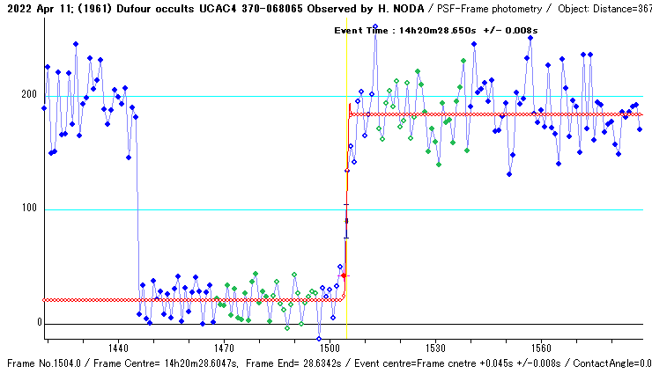
復光
Estimated Magnitude
Mag Drop : 2.39 +/- 0.04 Mag.
-Statistical analysis of Light Intensity-
Average Stdv n
Combined : 183.8 23.7 26
Background: 20.3 12.9 29
Noise Level (N/S) Upper Lower (S/N)
Total event: 0.1452 0.0788 6.89
- Event Time ----------------------------
Observed with 0 frame integration.
Event Time : 14h20m28.650s +/- 0.008s
Deriving process is :
T = To + Offset
= 14h20m28.6047s+0.045

